Slide 1
PhD Talks by VheP at the University of Newcastle Business School
Text analysis applications through social media for healthcare decision-making
A use case from Twitter!
Dr. Salvatore Pirri
s.pirri@regulatorypharmanet.com
October 2022

Slide 2

About me..
Website: https://salvatorepirri.netlify.app/
Email: salvatore.pirri@regulatorypharmanet.com

Slide 3
Agenda
Theoretical domain
Some definitions:
Artificial Intelligence (AI) vs Machine Learning (ML) vs Big Data
Differences among ML techniques (Supervised and Unsupervised)
Social Media platform: definition and applications in healthcare
Practical applications
Practical applications from twitter data:
Sentiment analysis and lexical
Topic modelling
Conclusions and remarks!

Slide 4

Aim(s)…
The purpose of this Lecture is to:
Provide an overview of the Social media analytics use through machine learning techniques, to analyze online content and users’ activities.
Present practical text analysis & ML application from online social media communities (twitter).

Slide 5
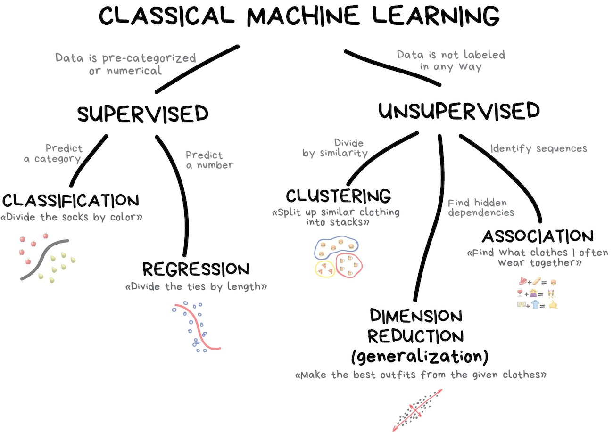
Theoretical domain Artificial Intelligence (AI) vs Machine Learning (ML) vs Big Data
In Machine Learning there are two basic approaches:
Supervised learning and unsupervised learning. The main difference is that supervised machine learning relies on labelled input and output training data, whereas unsupervised learning processes unlabelled or raw data.
Source Web: https://www.ibm.com/cloud/blog/supervised-vs-unsupervised-learning
Figure Source: https://devopedia.org/supervised-vs-unsupervised-learning

Slide 6
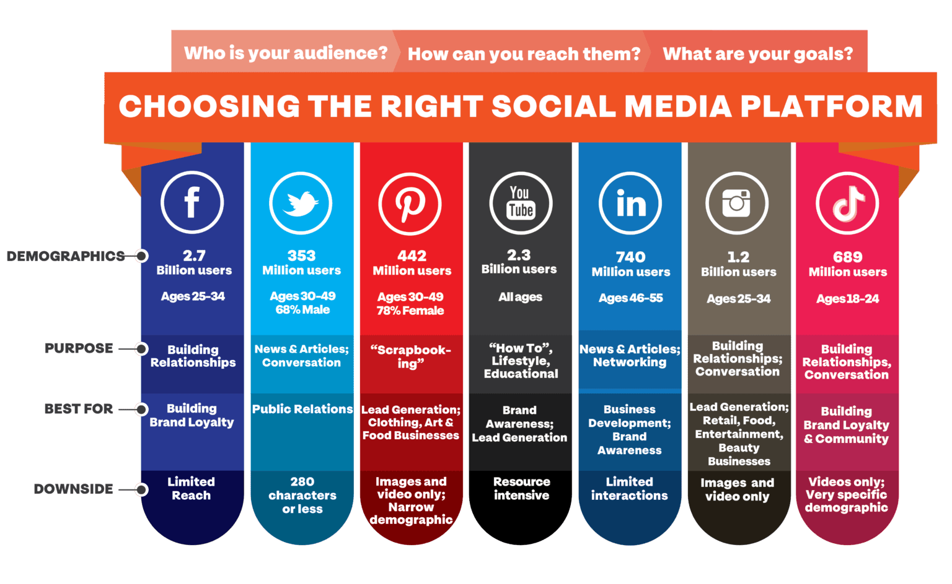

Theoretical domain Social Media Analytics for Health
Two important concepts to keep in mind…
Platform design
Privacy setting
Social media are public space no matter how private your setting are !!!
Source: https://aofund.org/resource/choosing-right-social-media-platform-your-business/

Slide 7
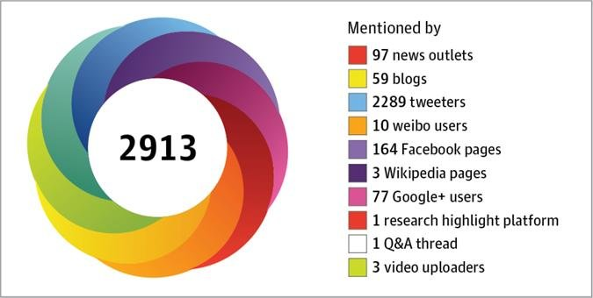
Practical applications Form theory to practise..
Why text analysis ?
Because it can be gathered from speech, newspaper articles, diary report, open survey answer, archival notes, website and social media platforms [1]…
Because text is essentially the main (but not the only) type of information we can capture from social media; performing several type of ML techniques, gathering suitable information for inferential statistics, users’ behavior and predicative analytics.
Why Twitter ?
Twitter has particularly gained traction among healthcare professionals and researchers [2]. While allowing users to freely read public messages up to 140 characters, only registered users can write and mention other users (by using the symbol @) and mark keywords or topics in a tweet using hashtags (#)
Social media-based metrics, also called “altmetrics”, create new ways to assess scientific impact →
And (most important) twitter allows trough a dedicated API to collect all the requested information.
https://www.altmetric.com/
[1] Grimmer, J., & Stewart, B. (2013). Text as Data: The Promise and Pitfalls of Automatic Content Analysis Methods for Political Texts. Political Analysis, 21(3), 267-297. doi:10.1093/pan/mps028
[2] B.L. Neiger, R. Thackeray, S.H. Burton, et al.Use of twitter among local health departments: an analysis of information sharing, engagement, and action; J. Med. Internet Res., 15 (8) (2013), p. e177, 10.2196/jmir.2775

Slide 8
Practical applications Form theory to practise..
Overview of text as data methods
Classification organizes texts into a set of categories. Sometimes researchers know the categories beforehand. In this case, automated methods can minimize the amount of labor needed to classify documents.
Dictionary methods, for example, use the frequency of key words to determine a document’s class.
Supervised methods begin with human hand coding of documents into a predetermined set of categories. Used techniques can be text analysis or classification.
Unsupervised methods will return classes that are theoretically interesting, obtained from unlabelled process. techniques can be clustering or LDA method.
Grimmer, J., & Stewart, B. (2013). Text as Data: The Promise and Pitfalls of Automatic Content Analysis Methods for Political Texts. Political Analysis, 21(3), 267-297. doi:10.1093/pan/mps028

Slide 9

Practical applications Form theory to practise..
Overview of text as data methods
Classification organizes texts into a set of categories. Sometimes researchers know the categories beforehand. In this case, automated methods can minimize the amount of labor needed to classify documents.
Dictionary methods, for example, use the frequency of key words to determine a document’s class.
Supervised methods begin with human hand coding of documents into a predetermined set of categories. Used techniques can be topics or sentiment analysis.
Unsupervised methods will return classes that are theoretically interesting, obtained from unlabelled process. techniques can be clustering or LDA method.
Supervised
Grimmer, J., & Stewart, B. (2013). Text as Data: The Promise and Pitfalls of Automatic Content Analysis Methods for Political Texts. Political Analysis, 21(3), 267-297. doi:10.1093/pan/mps028

Slide 10

Practical applications Form theory to practise..
Overview of text as data methods
Classification organizes texts into a set of categories. Sometimes researchers know the categories beforehand. In this case, automated methods can minimize the amount of labor needed to classify documents.
Dictionary methods, for example, use the frequency of key words to determine a document’s class.
Supervised methods begin with human hand coding of documents into a predetermined set of categories. Used techniques can be text analysis or classification.
Unsupervised methods will return classes that are theoretically interesting, obtained from unlabelled process. techniques can be clustering or LDA method.
Supervised
Unsupervised
Grimmer, J., & Stewart, B. (2013). Text as Data: The Promise and Pitfalls of Automatic Content Analysis Methods for Political Texts. Political Analysis, 21(3), 267-297. doi:10.1093/pan/mps028

Slide 11
Practical applications Form theory to practise..
Practical examples.. 💻

Slide 12
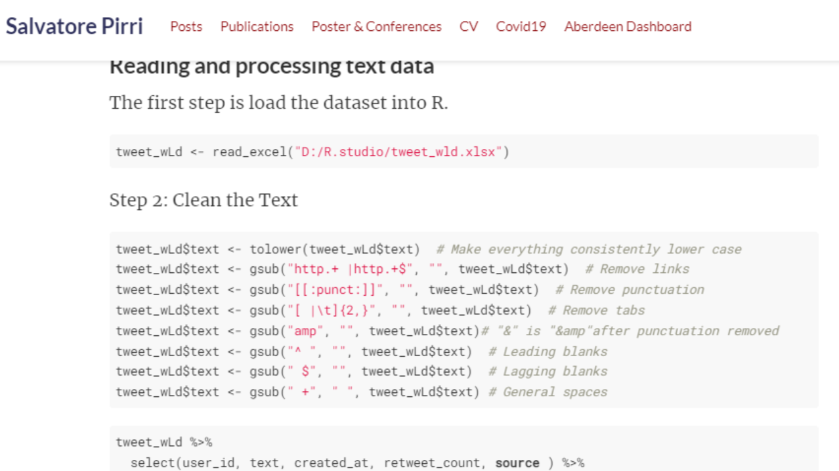
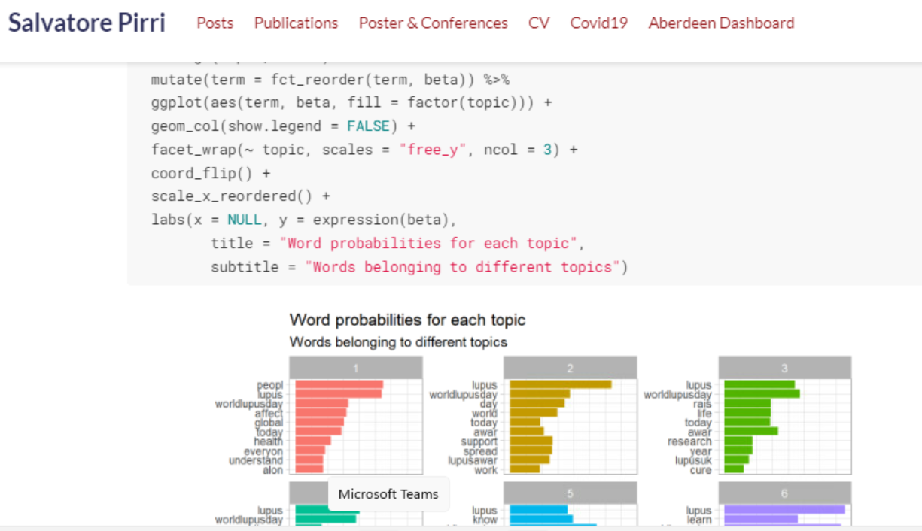
In conclusions
R code available for the proposed text analysis techniques and studies
https://salvatorepirri.netlify.app/

Slide 13


Thanks for your attention
Regulatory Pharma Net srl
Corso Italia, 116 - 56125 Pisa, Italy
Phone: +39 050 9134
Contacts:
Salvatore Pirri: Value & Market Access Specialist s.pirri@regulatorypharmanet.com
Lucia Piampiani: Operations and Value & Access Director l.piampiani@regulatorypharmanet.com
Patrizia Berto: Senior Vice President Value & Access p.berto@regulatorypharmanet.com

